Slide 1
CSE115
Lecture 11
Dr. Mohammad Abu Yousuf (MAY)

Slide 2
Multi-dimensional Array
Syntax:
storage-class data- type array[ expression1] [expression2] . . . [ expression n] ;
where storage-class refers to the storage class of the array, data- type is its data type, array is the array name, and expression 1, expression 2, . . ., expression n are positive-valued integer expressions that indicate the number of array elements associated with each subscript.
Remember that the storage-class is optional; the default values are automatic for arrays that are defined inside of a function, and external for arrays defined outside of a function.

Slide 3
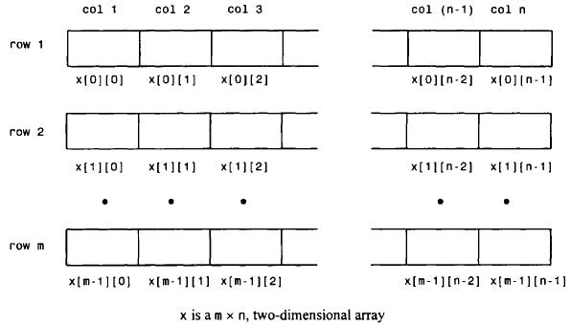
An m x n, two-dimensional array can be thought of as a table of values having m rows and n columns

Slide 4
Example:
float table[50][50];
char page[24][80];
double records[100][66][255];
double records[L][M][N];
int values[3][4] = {1, 2, 3, 4, 5, 6, 7, 8, 9, 10, 11, 12};
Note that values can be thought of as a table having 3 rows and 4 columns (4 elements per row).
values[0][0] = 1 values[0][1] = 2 values[0][2] = 3 values[0][3] = 4
values[1][0] = 5 values[1][1] = 6 values[1][2] = 7 values[1][3] = 8
values[2][0] = 9 values[2][1] = 10 values[2][2] = 11 values[2][3] = 12

Slide 5



Variation of the two-dimensional array definition
This definition results in the same initial assignments as in the last example.
Now consider :
This definition assigns values only to the first three elements in each row.

Slide 6

Then three of the array elements will again be assigned zeros, though the order of the assignments will be different.

Slide 7
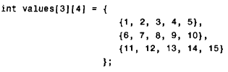
Finally, consider the array definition
This will result in a compilation error, since the number of values in each inner pair of braces (five values in each pair) exceeds the defined array size (four elements in each row).

Slide 8
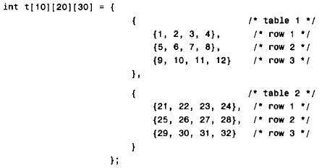
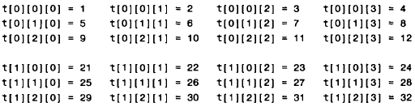
Consider the following three-dimensional array definition
All of the remaining array elements will be assigned zeros

Slide 9
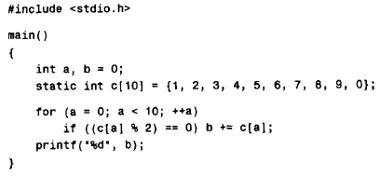
Find output

Slide 10
Output of previous program:
20 (sum of the array elements whose values are even)

Slide 11
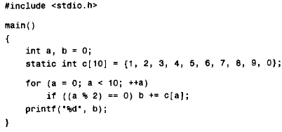

Slide 12
Output of previous program:
25 (sum of the even array elements)

Slide 13
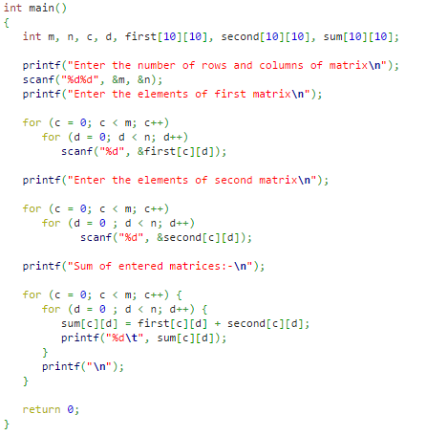
C program to add two matrix:

Slide 14
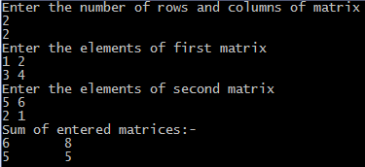
Output of previous program:

